Slide 1
Mental Health Improvement Team
Suicide Prevention Week Flash Report - 10th - 16th Sept 2023
National Suicide Prevention Week is an opportunity to create awareness of this leading cause of death
Suicide is a significant public health issue across Lanarkshire. North and South Lanarkshire Suicide Prevention multi agency forums lead on the delivery of suicide prevention, directed by the National Suicide Prevention Advisory Collective, COSLA and Public Health Scotland. It is important to take action to help raise our awareness and encourage others to talk about mental health and suicide.
Time, Space and Compassion
Football Tournament, Carluke
Sun 10th Sept 3,pm John Cumming Stadium
Suicide prevention conversations at some of our local community cafes and spaces. For details go to
https://www.elament.org.uk/self-help-resources/suicide-prevention-week-2023/
Ask, Tell Training Sessions
Mon 11th Sept 9.30-11.30 Thurs 14th Sept 2pm- 4pm
To book a place and for any specific training needs email publicmentalhealth@lanarkshire.scot.nhs.uk
Suicide Prevention 7 a side Football Tournament.
Wed 13th Sept 9am-3pm Ravenscraig Regional Sports Facility
Email football@northlan.gov.uk
Distribution of Suicide Prevention Coasters
10,000 ‘Every Life Matters’ drinks coasters will be distributed across pubs, restaurants and eateries in South Lanarkshire, including what to look out for if you are concerned about someone and details of crisis supports available.
New Video campaign North Lanarkshire Suicide Prevention will be launching a new Suicide Prevention video campaign
https://www.northlanarkshire.gov.uk/social-care-and-health/suicide-prevention-nl
Time
At a point of suicidal crisis, people need the time to discuss their feelings and to tell their story about what has led them to feel that acting on their thoughts of suicide is their only option.
Space
Physical spaces for people who seek support in suicidal crisis should be accessible, quiet, comfortable, pleasant and take account of emotional and physiological needs.
Compassion
A compassionate response to someone in suicidal distress requires meeting the person where they are with attention, empathy and a desire to assist on their terms.
An overview of findings - Time, Space, Compassion Three simple words, one big difference: Recommendations for improvements in suicidal crisis response - gov.scot (www.gov.scot)
Texas Scramble Charity Golf Tournament , East Kilbride
Fri 8th Sept 9.30am Calderglen Country Park
Email colin.girvan@southlanarkshireleisure.co.uk
Health Walk, Lanark
Fri 8th Sept 10am Castlebank Park, Lanark
Suicide Prevention Week – 10th – 16th Sept

Slide 2
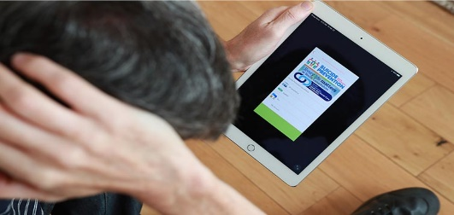
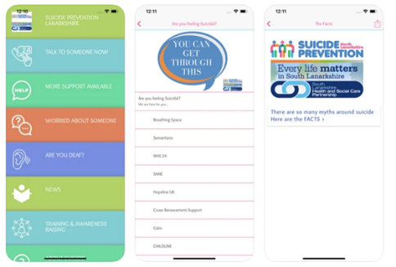
Health Improvement
Training
Samaritans Campaign
You have all the experience you need to save a life,
trust your instincts, start a conversation. For more info go to:
https://www.samaritans.org/scotland/support-us/campaign/small-talk-saves-lives/tincts, start a conversation.
There are different levels of Suicide Prevention training from a one hour online ALERT briefing, to a two hour Ask Tell training session, which includes (Mental Health, Healthy Conversations and Suicide Prevention). This also highlights local guidance and supports. There is also a more intensive two day ASIST training designed to give skills in applied interventions when in contact with people who may have thoughts of suicide.
.30 am – 11.30 am & u 1^{h}
Ask, Tell Training dates during SP week;
Mon 11th Sept 9.30-11.30
Thurs 14th Sept 2pm- 4pm
To book a place & for any specific training needs email publicmentalhealth@lanarkshire.scot.nhs.uk ad with these dates
The SP Lanarkshire App is full of information to help keep people safe and guidance on how to look out for others, who you may be concerned about. Download free from your App Store. Search for SP Lanarkshire
Lanarkshire Resources
Keepsafe Resource Links - Offer support for anyone struggling
with their mental health or thinking about suicide.
South Lanarkshire Resource - Can help with tips to look out for
if you are concerned about someone and crisis support details.
Suicide Prevention (SP) Lanarkshire App
69 participated in the online pilot
We all have bad days, but for some people, life just feels too hard. Anyone could have these feelings and it's sometimes the person we least expect that is suffering. But with help, these feelings can be overcome. It starts with reaching out, so Let's Talk.
https://www.northlanarkshire.gov.uk/social-care-and-health/suicide-prevention-nl/lets-talk
Support details
If you are feeling suicidal, phone the Samaritans on 116123 (free 24-hour service or visit www.Samaritans.org) or Breathing Space on 0800 83 85 87 (free to call between 9pm and 2am or visit www.breathingspace.scot). If you are a young person contact
Childline on 0800 1111 24/7 or Hopeline 9am to midnight on 0800 068 41 41

